Slide 1
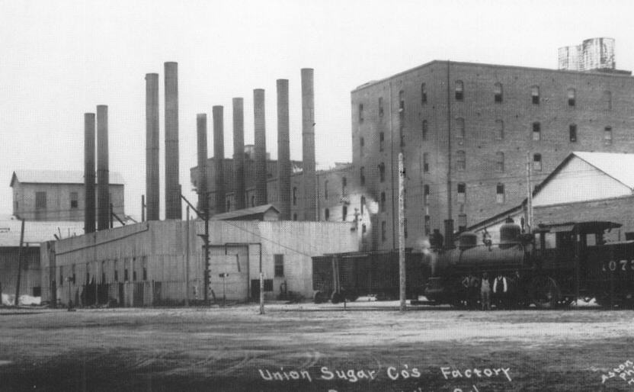
Sugar Mill, 1899

Slide 2
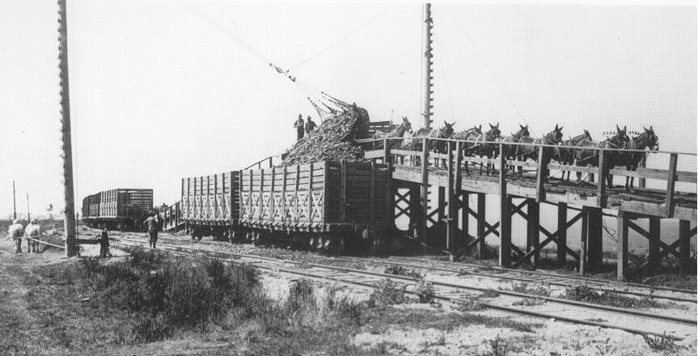
Sugar beets dumped from carts to railroad cars, 1920s

Slide 3
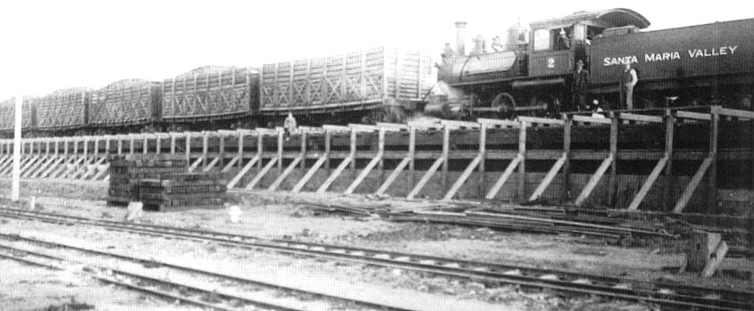
Sugar Mill Highline, 1920s

Slide 4
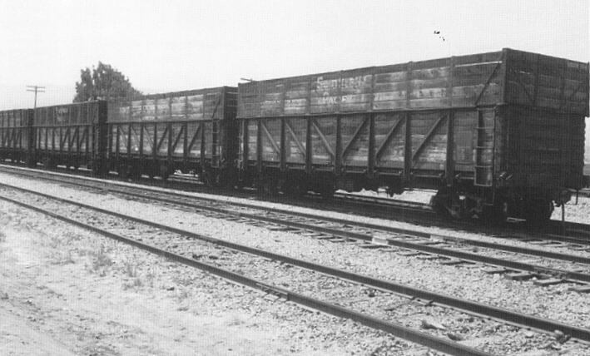
Sugar beet gondolas

Slide 5
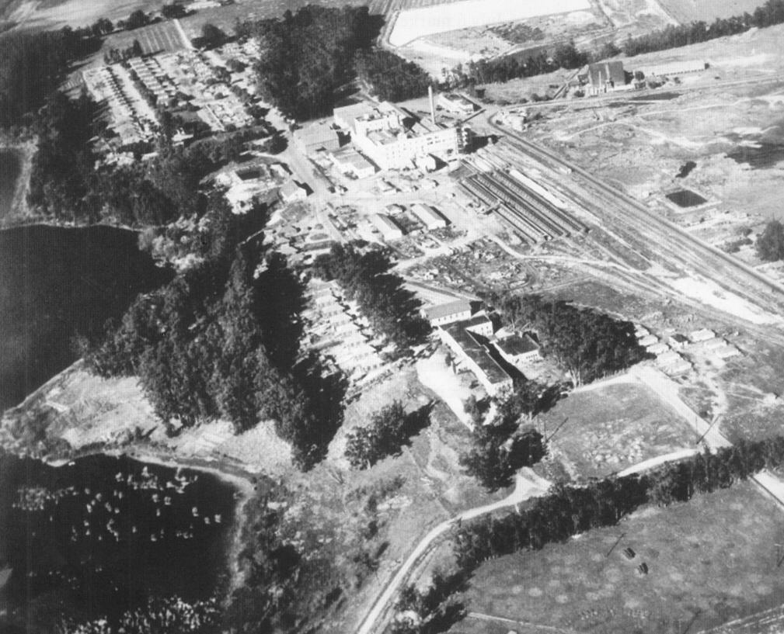
Betteravia early 1900s
Sugar Mill

Slide 6
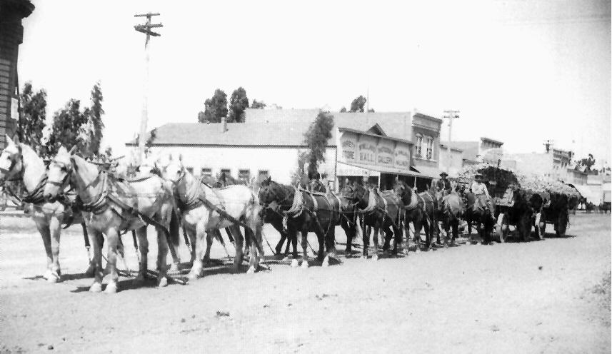
Sugar beet horse team in town

Slide 7
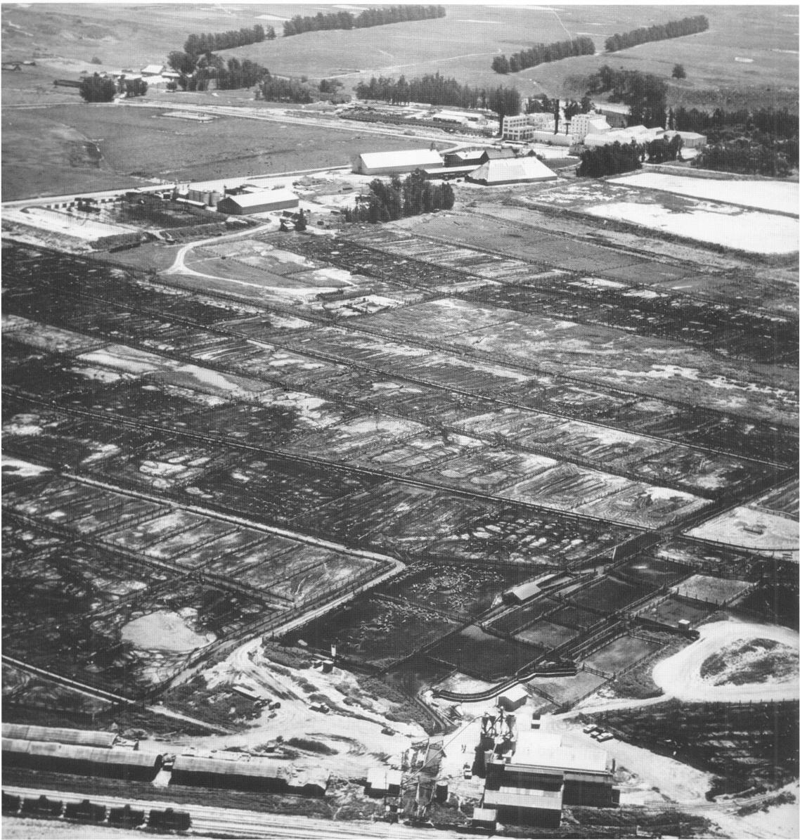
Feedlots

Slide 8
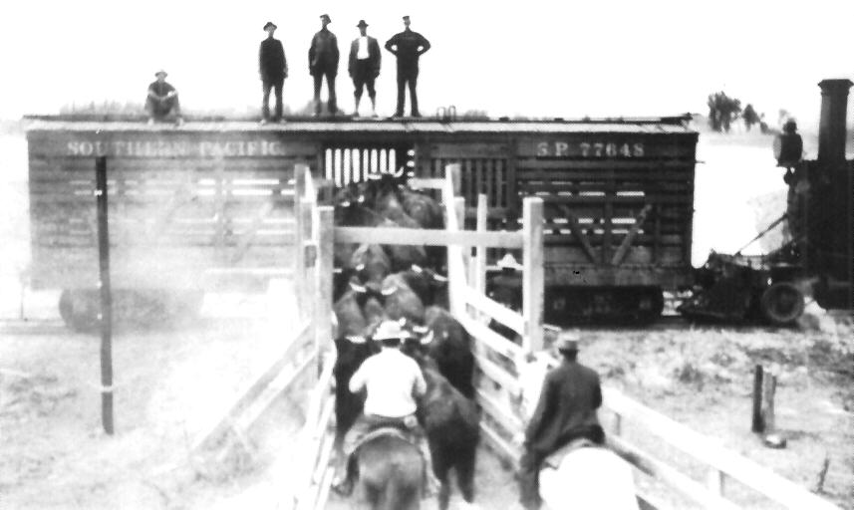
Loading cattle onto boxcars at the feedlots

Slide 9
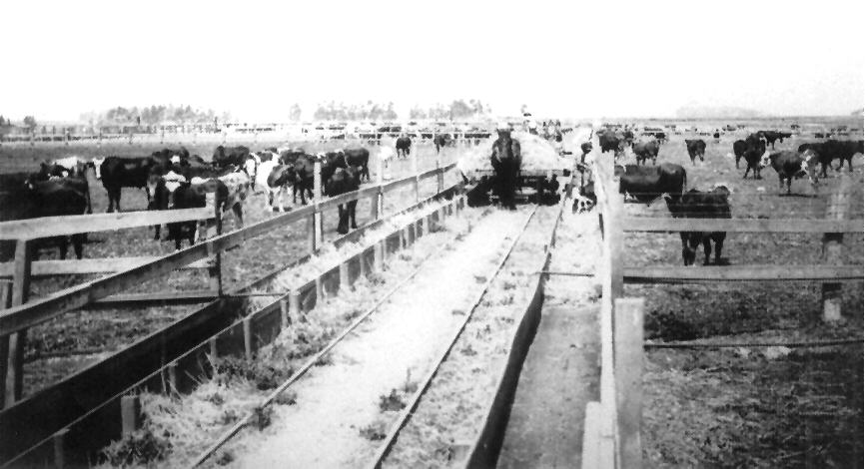
Feedlot carts on rails

Slide 10
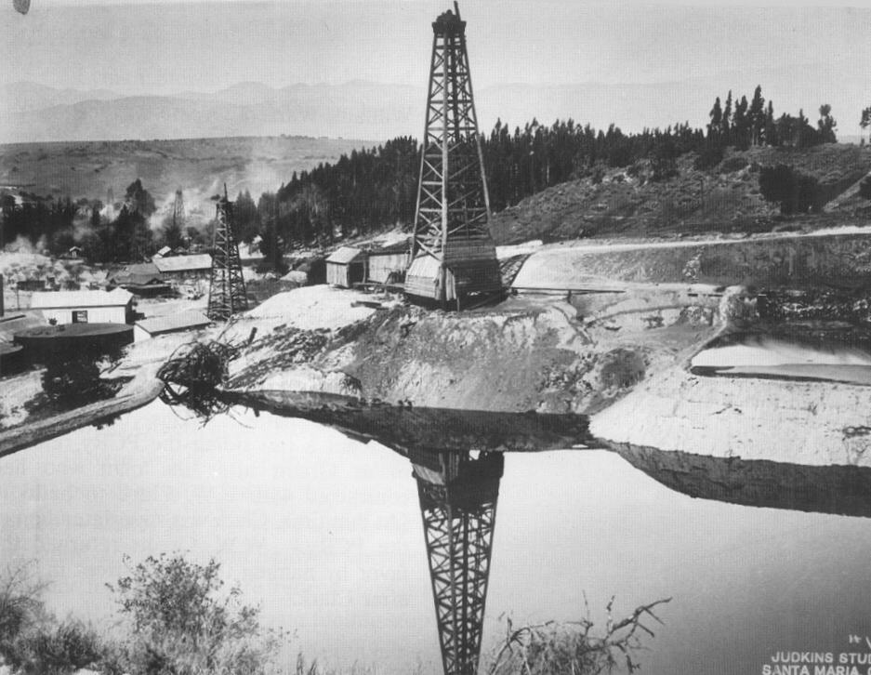
Oil fields at Roadamite, early 1900s

Slide 11
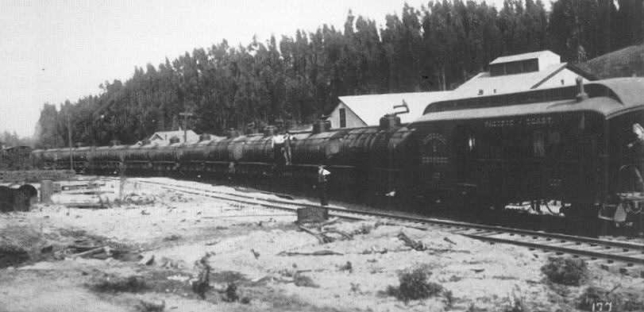
Roadamite oil train 1890-1929

Slide 12
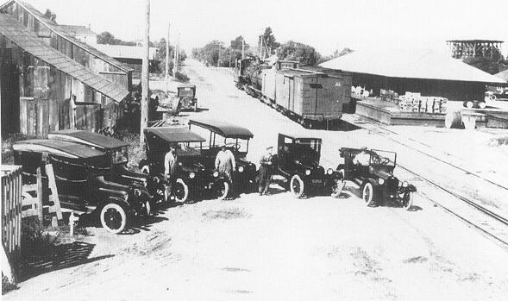
1920s

Slide 13
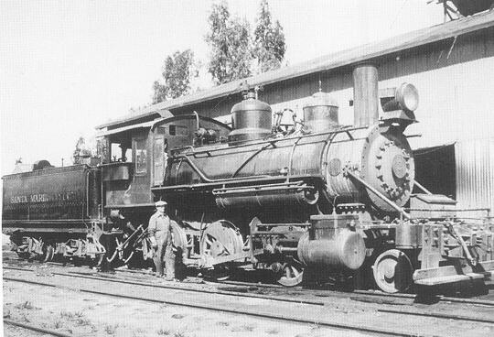
1920s

Slide 14
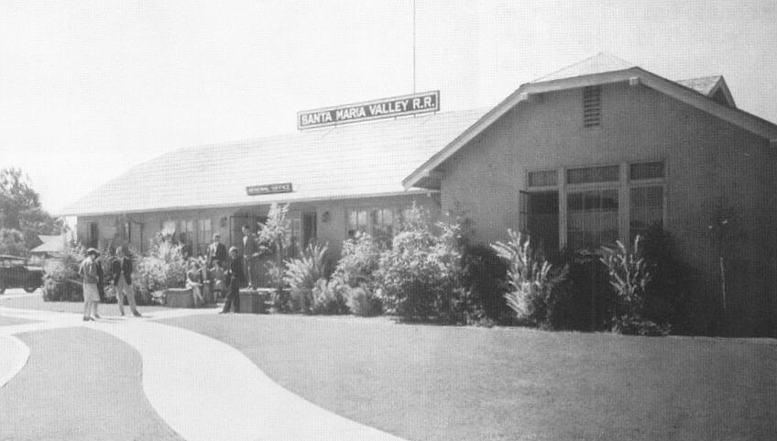
SMVRR office built 1920s

Slide 15
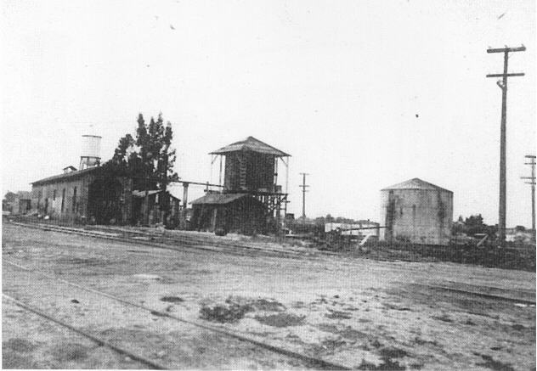
Yard area, 1925

Slide 16
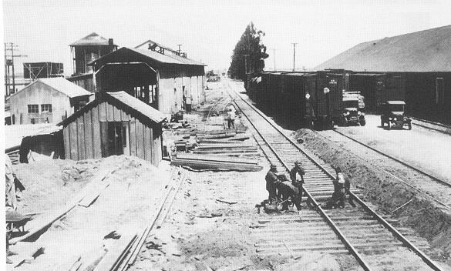
1925

Slide 17
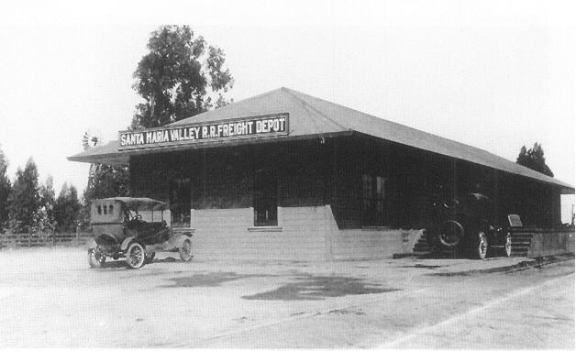
Depot - 1925

Slide 18
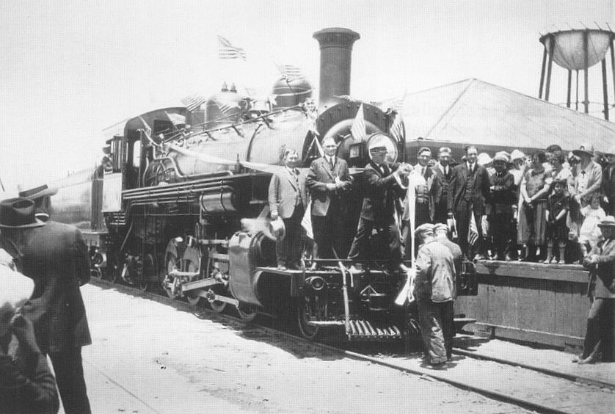
No. 21 in 1925

Slide 19
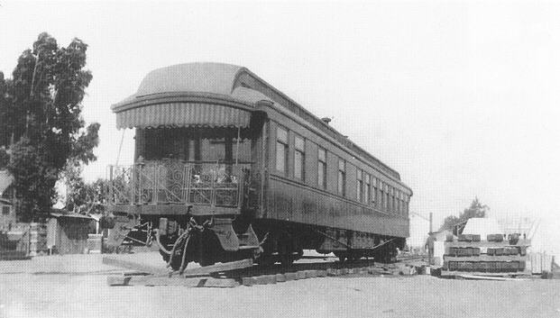
Capt. Hancock’s Car

Slide 20
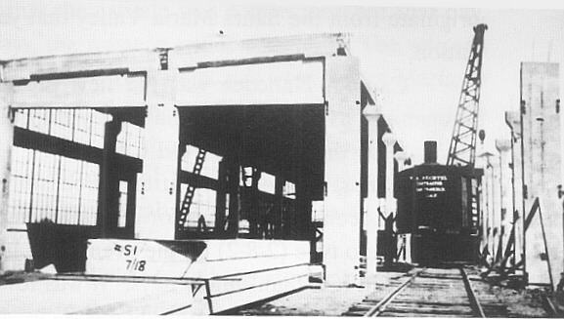
Enginehouse construction 1925-1926

Slide 21
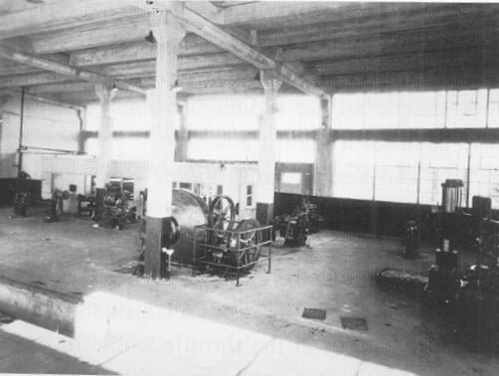
Enginehouse, pit exposed, 1920s

Slide 22
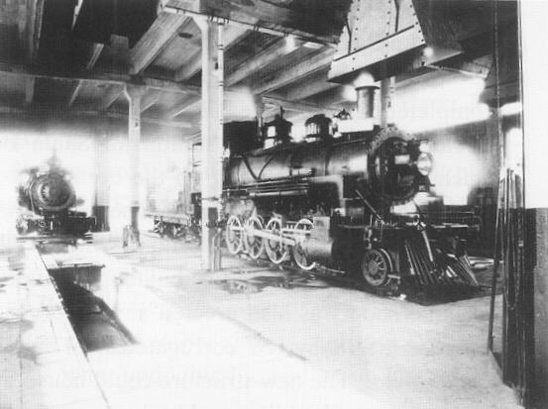
Enginehouse with steam locomotive

Slide 23
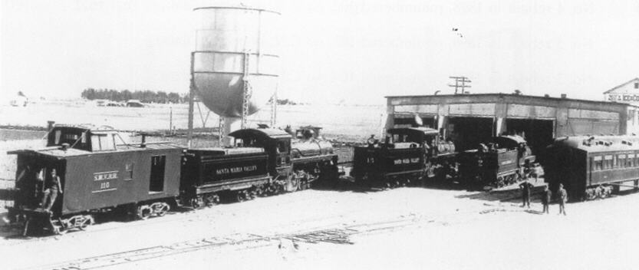
Yard and Enginehouse 1927

Slide 24
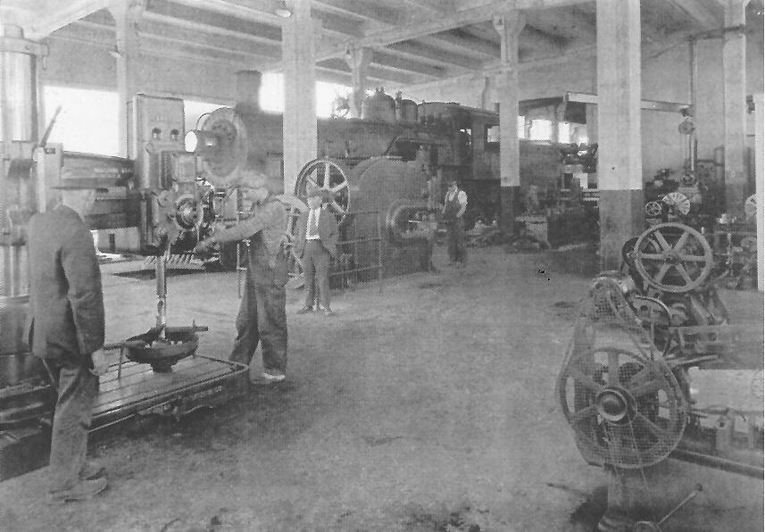
Enginehouse, days of steam
c1930

Slide 25
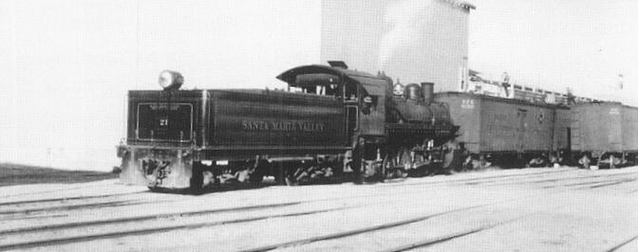
Pacific Fruit Express iced boxcars - produce

Slide 26
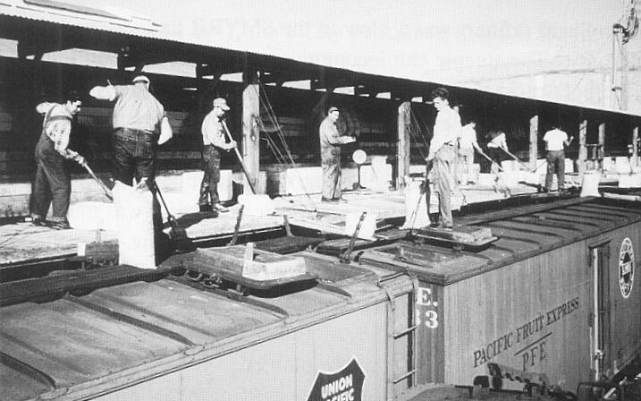
Pacific Fruit Express

Slide 27
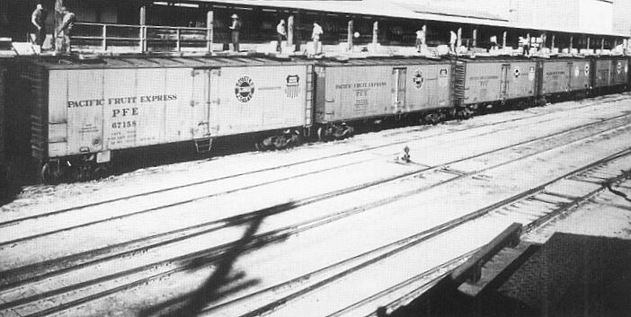
Pacific Fruit Express

Slide 28
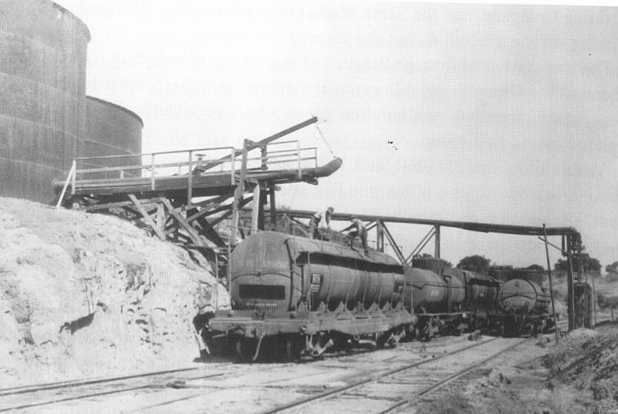
Roadamite oil

Slide 29
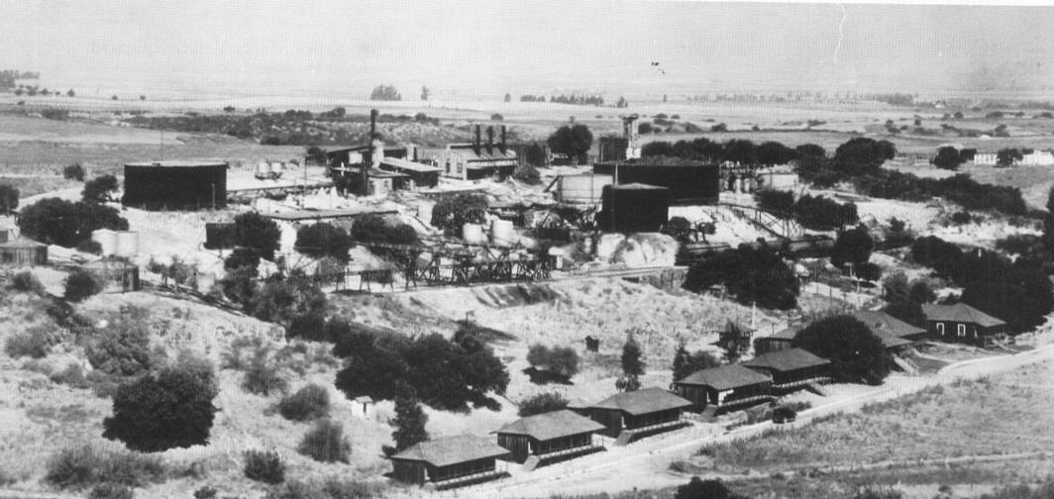
Roadamite oil

Slide 30
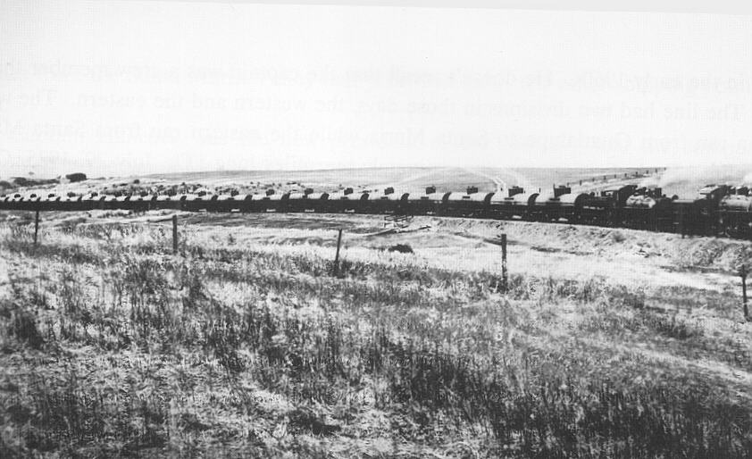
Roadamite oil train

Slide 31
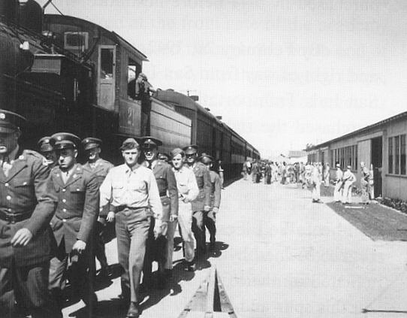
Servicemen transported, 1940s

Slide 32
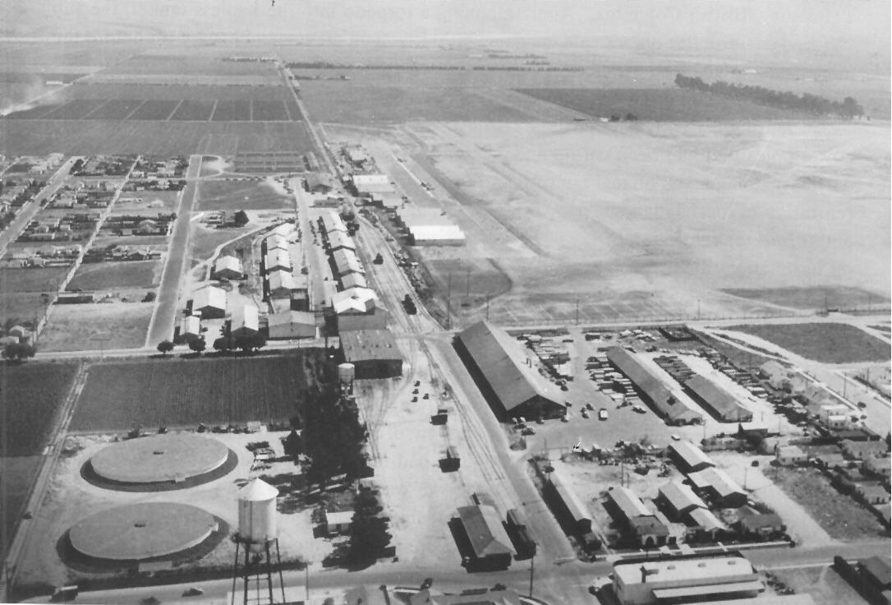
Yard about 1941

Slide 33
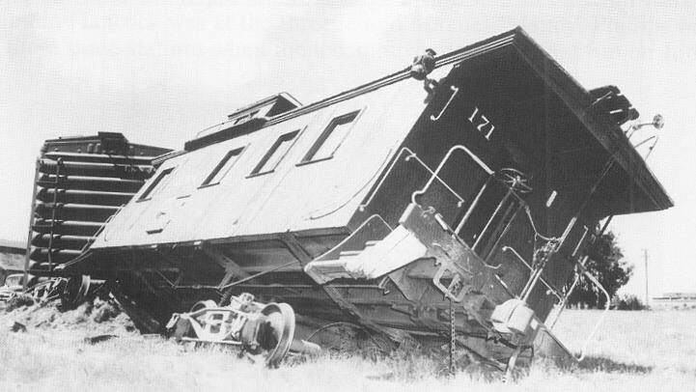
1948

Slide 34
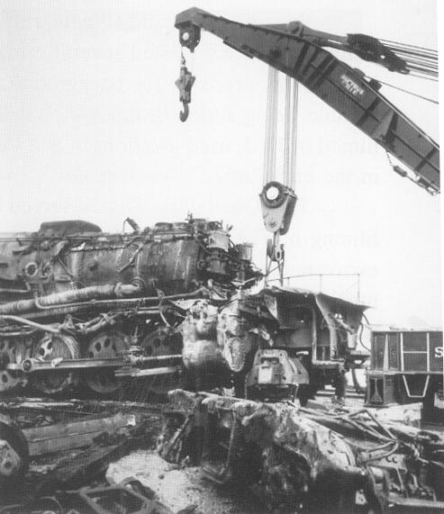
1952

Slide 35
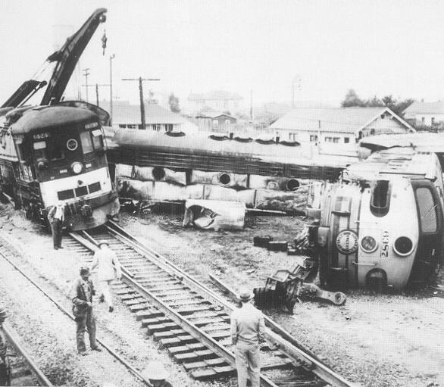
1952

Slide 36
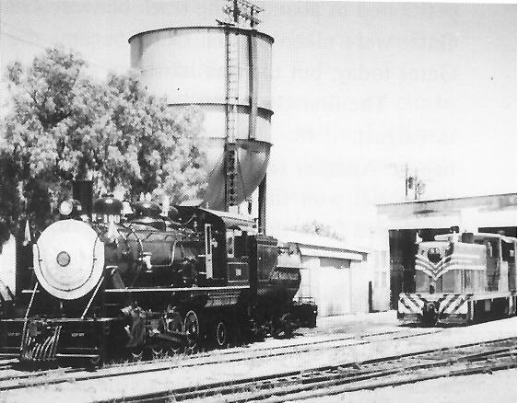
Diesel and steam 1958

Slide 37
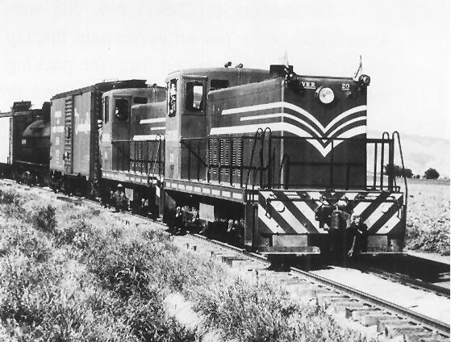
Too dark to be yellow.
1960s.

Slide 38
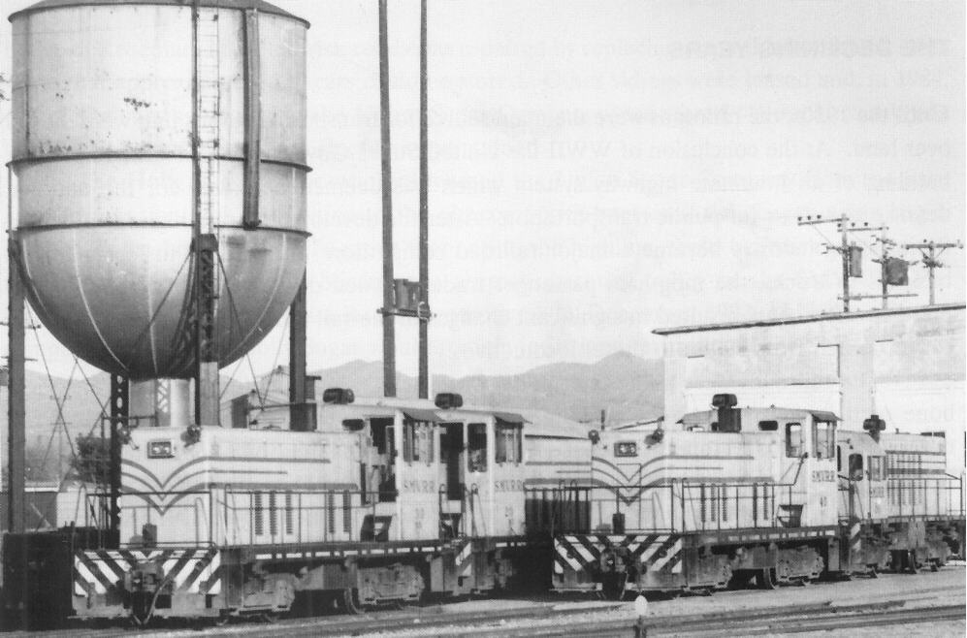
Yard and Enginehouse 1966

Slide 39
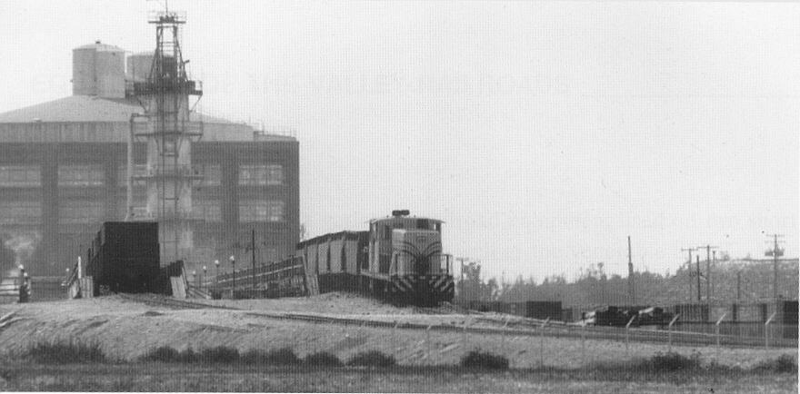
Sugar Mill Highline, 1982

Slide 40
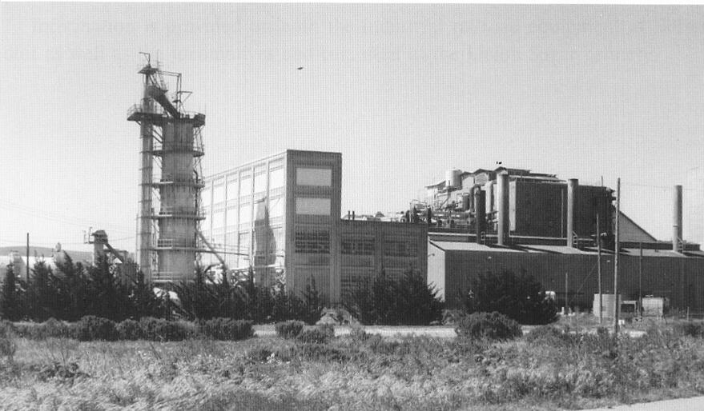
Sugar Mill 1982

Slide 41
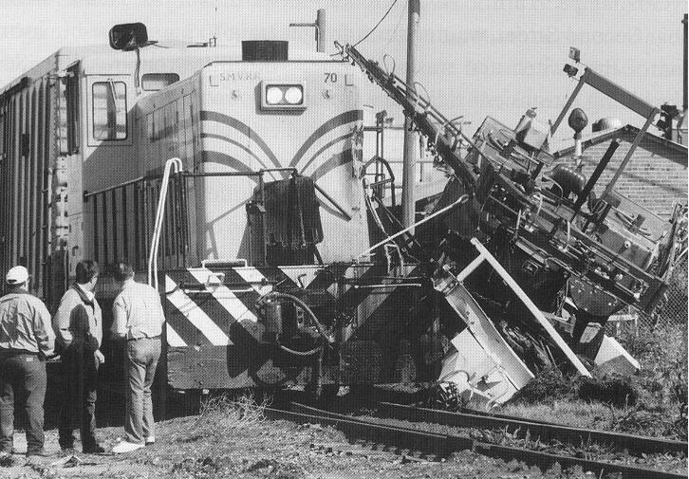
1998

Slide 42
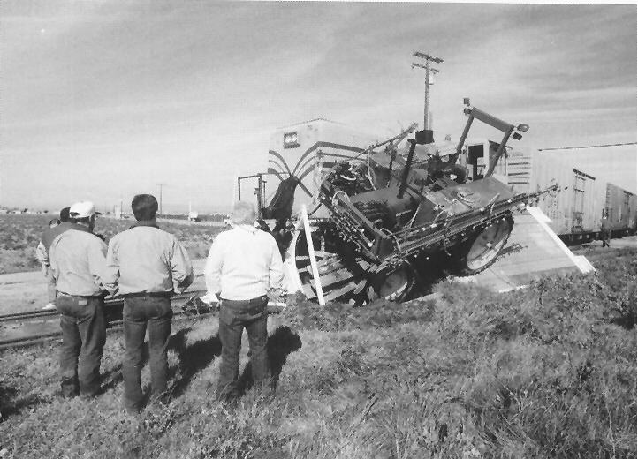
1998

Slide 43
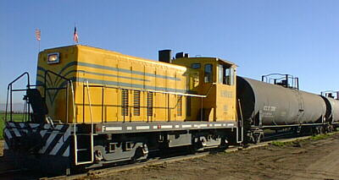
Today’s SMVRR

Slide 44
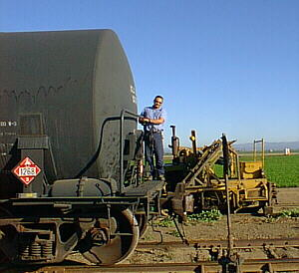
Conductor and brakeman!

Slide 45
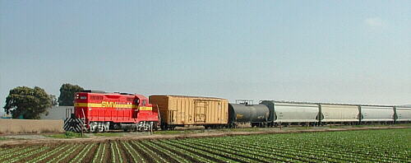
No. 1801

Slide 46
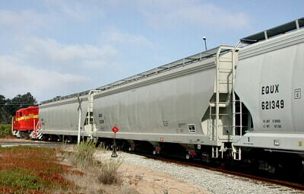
Spotting hopper cars at Conoco

Slide 47
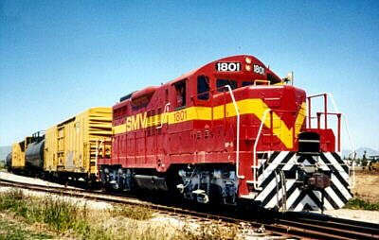
GP9 Diesel Locomotive

Slide 48
