Slide 1
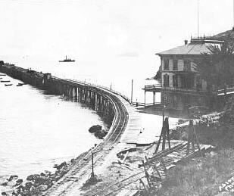
Pacific Coast Railway 1882-1942
Avila Bay
San Luis Obispo
Central City
Los Olivos
Notes:
Idea of “tracks” goes back 2000 years to the Greeks.
By 1550, German miners were using horse-drawn wagons with flanged wheels on tracks.

Slide 2
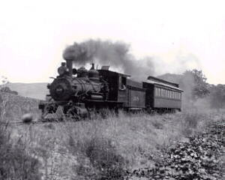
2-8-0 Steam Locomotive
1905

Slide 3
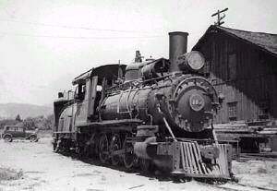
No. 110 at San Luis Obispo yard

Slide 4
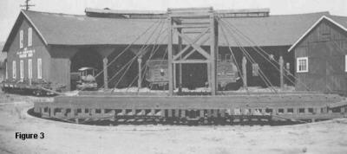
San Luis Obispo 1930s roundhouse and turntable

Slide 5
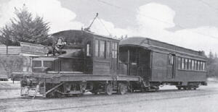
Electric train; No. 300 Santa Maria - Guadalupe

Slide 6
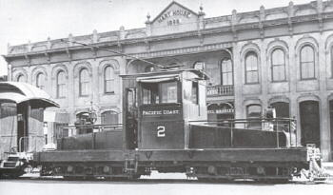
Electric service to Guadalupe, 1909; mostly used for sugar beets

Slide 7
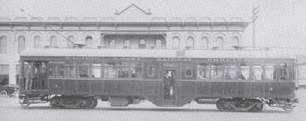
Hart House, Santa Maria 1912; interurban passenger

Slide 8
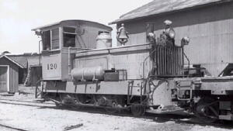
1940s, first PCRy diesel

Slide 9
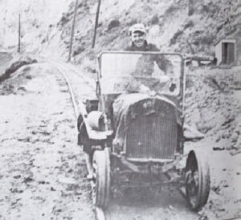
Railcar near Avila Bay

Slide 10
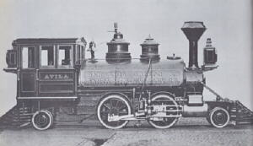
The “Avila”, original locomotive for SLO&SMV RR which eventually became the PCRy

Slide 11
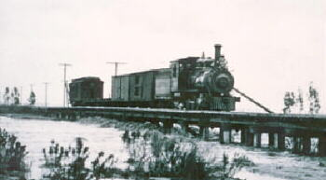
Mixed consist crossing Santa Maria River, circa 1910

Slide 12
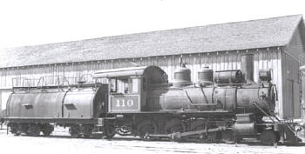
No. 110, SLO 1940, with whaleback tender

