Slide 1
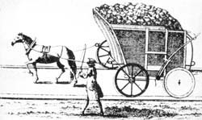
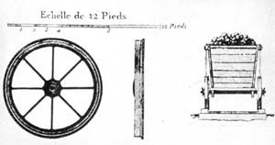
1550 – Horse drawn carts on timbers in Germany
Notes:
Idea of “tracks” goes back 2000 years to the Greeks.
By 1550, German miners were using horse-drawn wagons with flanged wheels on tracks.

Slide 2
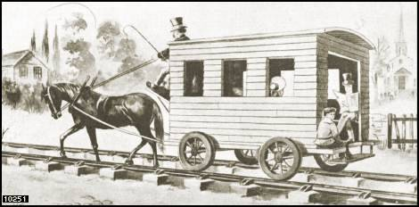
1700s – early 1800s Horse Drawn Coaches
Notes:
Iron replaces wood for the rails and wheels.

Slide 3
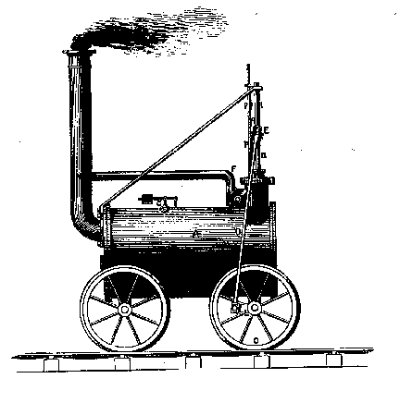
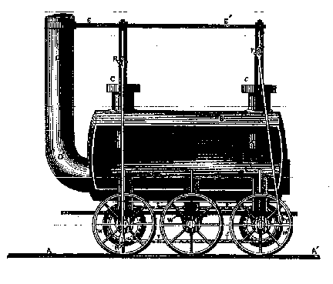
1804 / 1815
Notes:
February 22, 1804 – world’s first steam locomotive pulls 10 tons of iron, 70 men, and 5 extra wagons for 9 miles.
Some features in this first loco were still in use 150 years later.

Slide 4
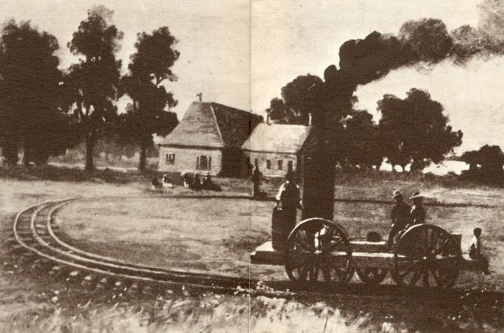
1825
Notes:
Colonel John Stevens
Hudson Terrace
Hoboken, NJ

Slide 5
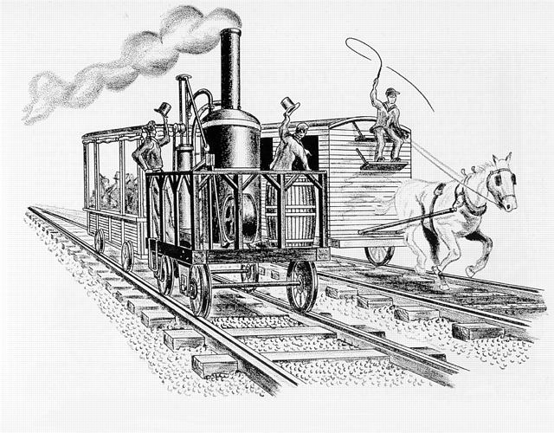
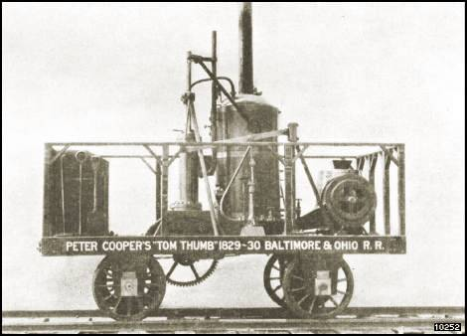
1829 Tom Thumb
Notes:
Built in NY in 6 weeks for the B&O Railroad.
Hauled 36 passengers at 18mph in August 1830.
In the early days of steam locomotives, they were often pitted against horse teams, and lost some of the first races.

Slide 6
1831 – John Bull
Notes:
First loco with a bell, headlight, and cowcatcher.
Ran until 1866.
Assembled by a man unfamiliar with locos and without benefit of a manual after parts were shipped from England to New Jersey.

Slide 7
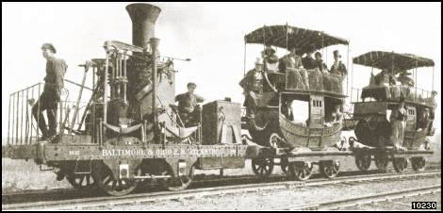
1832 – the “Atlantic”
Notes:
York, Pennsylvania.
Note stagecoach-like passenger cars.

Slide 8
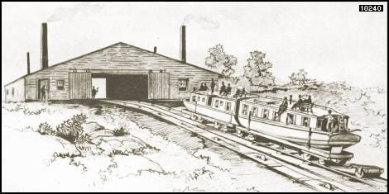
1835 – canal boat on incline
Notes:
Early rail systems were combined with canals and other waterways.

Slide 9
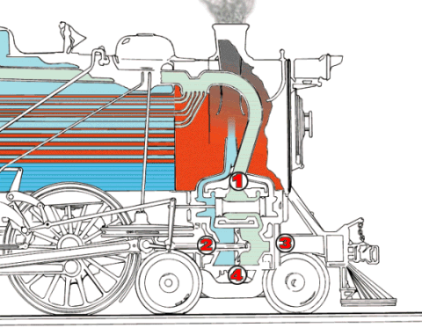
Steam Locomotive
Notes:
Burned coal, wood, or oil to make fire.
Fire boils water to make steam.
Steam pressure drives the pistons in the valves.
The pistons are attached to the drive wheels.

Slide 10
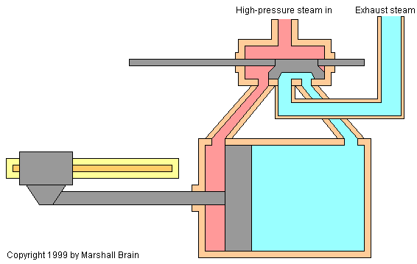
Watch it work...
Notes:
Red = hot pressurized steam.
Blue = cooled exhaust steam.

Slide 11
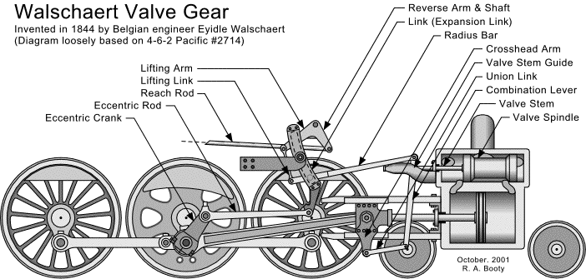
Steam Locomotive Valve Gear

Slide 12
Watch it work

Slide 13
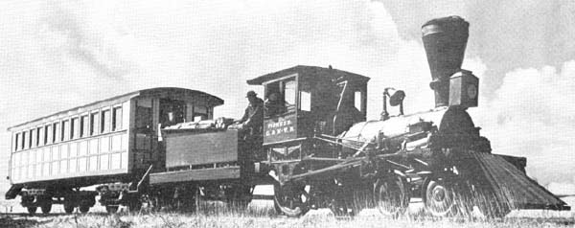
1848 – Chicago & North Western
Notes:
The “Pioneer” was the first locomotive in Chicago.
Passengers and goods now readily moved easily across great distances.

Slide 14
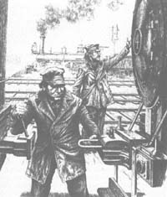
1868 Automatic Coupler
Notes:
Pictured here is an old loop-and-pin coupling system that required the brakeman to get between the cars and risk fingers, hands, arms, and even life itself.
The automatic modern coupler greatly reduced injury and other mishaps.

Slide 15
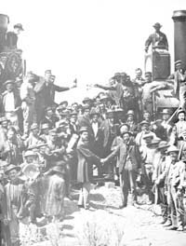
1869 Transcontinental Railroad is complete Golden Spike Promontory, Utah
Notes:
Abraham Lincoln signed the Pacific Railroad Act of 1862 permitting the first transcontinental railroad.
Union Pacific went west from Omaha 1038 miles.
Central Pacific went east from Sacramento 742 miles.

Slide 16
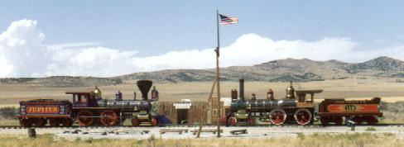
1869 – Golden Spike Re-enactment
Notes:
Trackage in 1860 was about 30,000 miles.
Trackage in 1900 was about 201,000 miles.
There are now 5 transcontinental railroad routes.

Slide 17
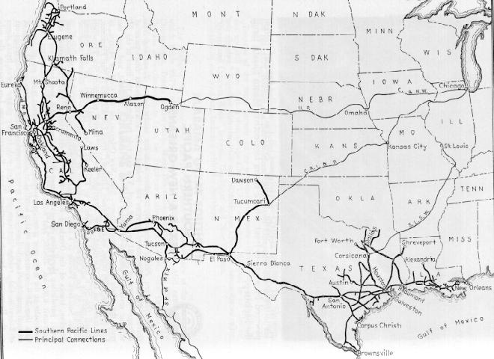
1883 – Southern Pacific RR
Notes:
The Southern Pacific was one of the premier railroads of the west.
Founded 1865.
Ultimately merged with the Union Pacific Railroad on 9/11/1996.

Slide 18
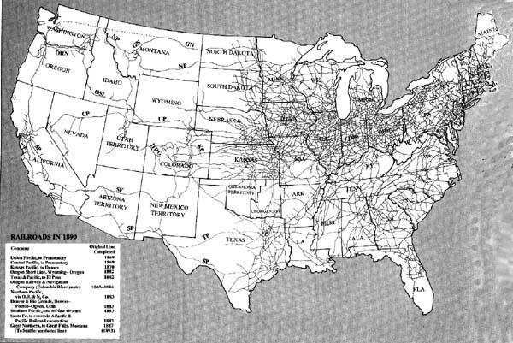
1890 U. S. Railroads
Notes:
Note the concentration of railroads in the east compared to the west.

Slide 19
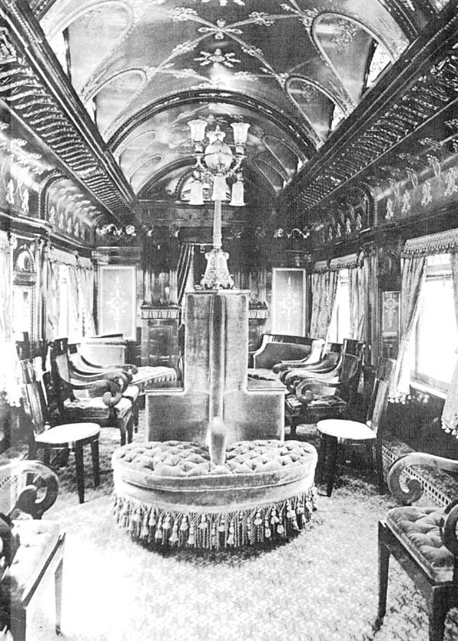
1890s Pullman Car
Notes:
The Isabella Pullman observation car.
“Palaces on Wheels”.

Slide 20
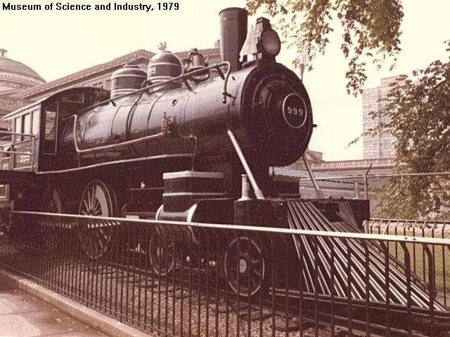
1893 New York Central 112.5mph
Notes:
NY Central and Hudson River RR No. 999 broke a speed record (though unverified):
112.5mph over 1 mile
102.8mph over 5 miles

Slide 21
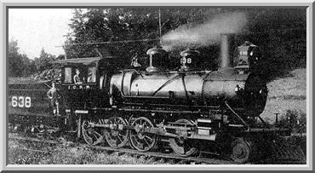
1900 – Casey Jones
Notes:
April 30, 1900
The “Cannonball”, really the “Chicago Fast Mail”.
John Luther ("Casey") Jones was the only casualty in a train wreck caused by equipment failures preventing a proper “meet” from taking place.

Slide 22
THE BALLAD OF CASEY JONES
Come all you rounders if you want to hear
A story 'bout a brave engineer,
Casey Jones was the rounder's name
"Twas on the Illinois Central that he won his fame.
Casey Jones, he loved a locomotive.
Casey Jones, a mighty man was he.
Casey Jones run his final locomotive
With the Cannonball Special on the old I.C.
Casey pulled into memphis on Number Four,
The engine foreman met him at the roundhouse door;
Said, "Joe Lewis won't be able to make his run
So you'll have to double out on Number One."
If I can have Sim Webb, my fireman, my engine 382,
Although I'm tired and weary, I'll take her through.
Put on my whistle that come in today
Cause I mean to keep her wailing as we ride and pray.
Casey Jones, mounted the cabin,
Casey Jones, with the orders in his hand.
Casey Jones, he mounted the cabin,
Started on his farewell Journey to the promised land.
They pulled out of Memphis nearly two hours late,
Soon they were speeding at a terrible rate.
And the people knew by the whistle's moan.
That the man at the throttle was Casey Jones.
Need more coal there, fireman Sim,
Open that door and heave it in.
Give that shovel all you got
And we'll reach Canton on the dot
On April 30, 1900, that rainy morn,
Down in Mississippi near the town of Vaughan,
Sped the Cannonball Special only two minutes late
Traveling 70 miles an hour when they saw a freight.
The caboose number 83 was on the main line,
Casey's last words were "Jump, Sim, while you have the time.
"At 3:52 that morning came the fareful end,
Casey took his farewell trip to the promised land.
Casey Jones, he died at the throttle,
With the whistle in his hand.
Casey Jones, he died at the throttlle,
But we'll all see Casey in the promised land.
His wife and three children were left to mourn
The tragic death of Casey on that April morn.
May God through His goodness keep them by His grace
Till they all meet together in that heavenly place.
Casey's body lies buried in Jackson, Tennessee
Close beside the tracks of the old I.C.
May his spirit live forever throughout the land
As the greatest of all heroes of a railroad man.
Casey Jones, he died at the throttle,
Casey Jones, with the whistle in his hand.
Casey Jones, he died at the throttle,
But we'll all see Casey in the promised land.

Slide 23
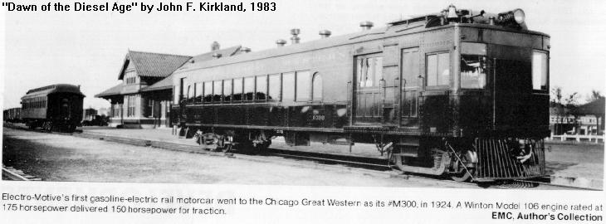
1923 – Diesel Age Dawns
Notes:
Diesel electric locomotives are developed.
Though not initially successful, they eventually replaced steam.

Slide 24
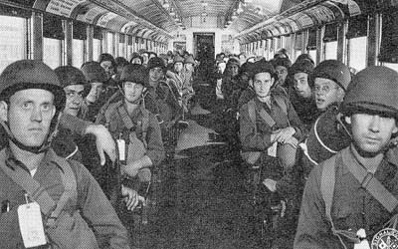
1942 – Troop Train
Notes:
Movement of people and goods is critical to military operations.
“Troop Trains” moved soldiers all over this country during World Wars I and II.

Slide 25
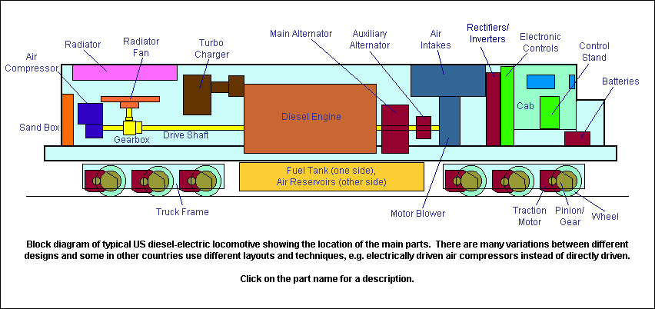
1940s – Today Modern Diesel Locomotive

Slide 26
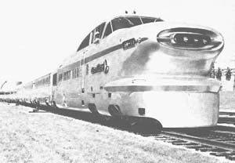
1955 – Streamlining

Slide 27
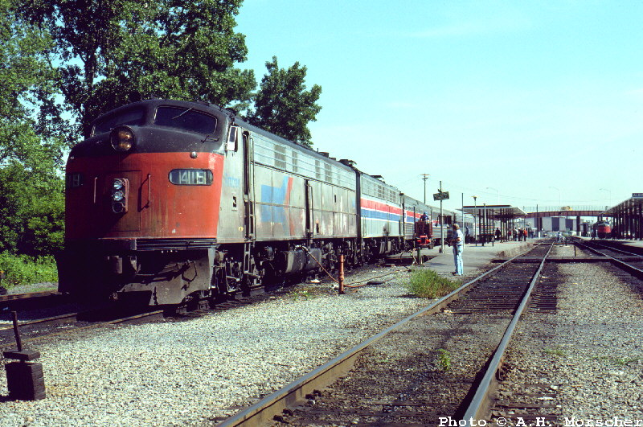
1970 – Amtrak Is Born National Passenger Service

Slide 28
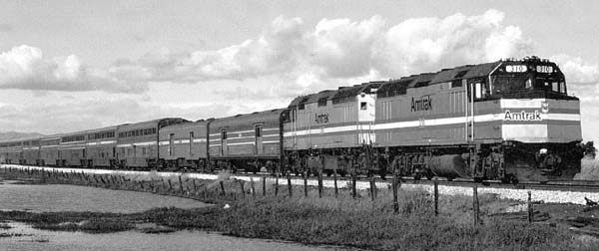
1980s – California Zephyr

Slide 29
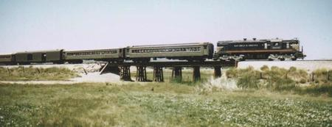
1986 - Excursion
Notes:
“Excursions” are trains “just for fun”.
Railroading fans are re-invigorating the use of some trains.

Slide 30
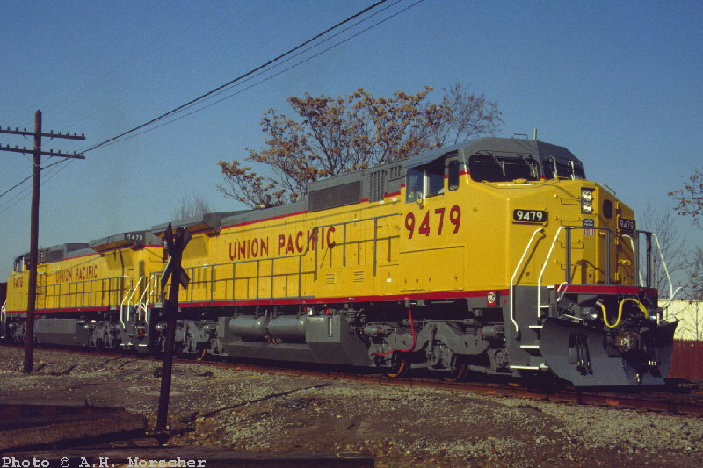
1990 – UP Diesel
Notes:
UP distinctive yellow with red markings.

Slide 31
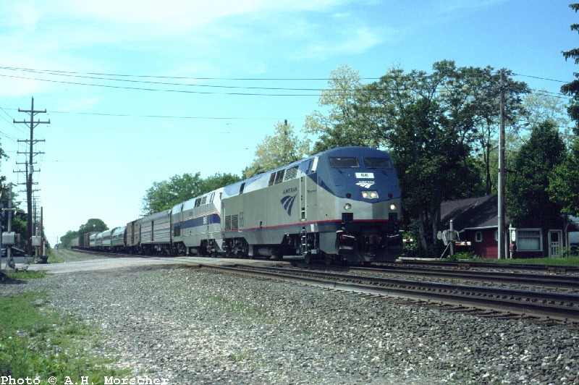
2001 - Amtrak

Slide 32
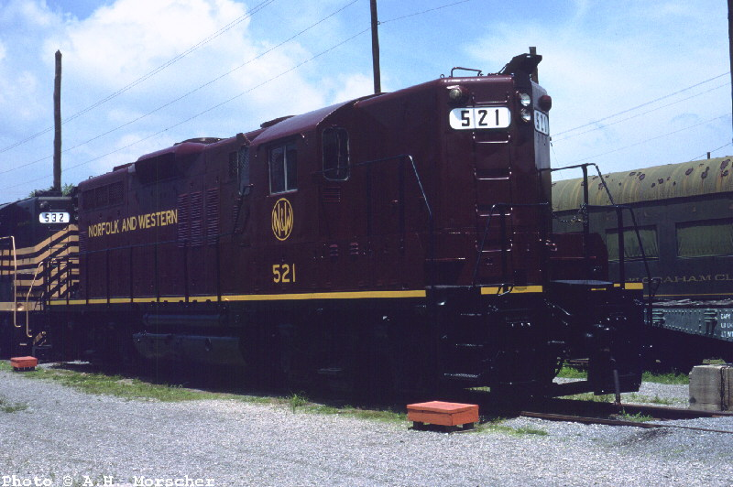
2001 – Norfolk & Western

Slide 33
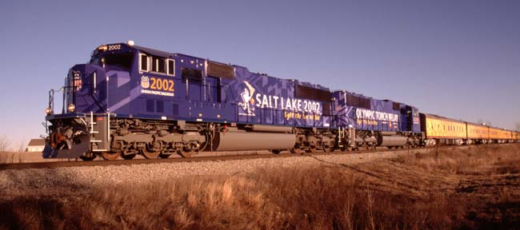
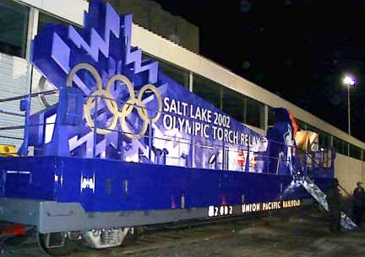
2002 Olympic Torch Train
Notes:
The flame boarded the train in Guadalupe during the evening of January 15, 2002 after being run through Santa Maria.

