Slide 1
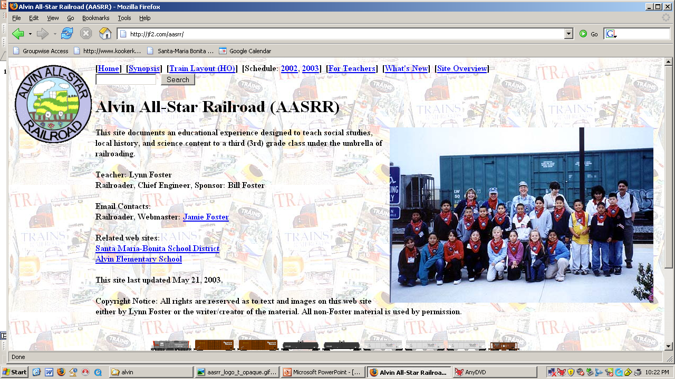
www.jf2.com/aasrr/

Slide 2
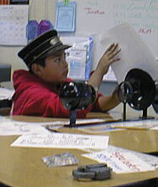
Third Grade
Local History
Social Studies
Science

Slide 3
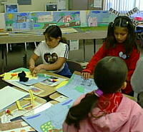
Art
Design the logo
3-D drawings of historical buildings (pictured at right)
Timeline images
Modeling of ground and structures on the HO Layout
Drawings for the Thank You Notes for the 3 field trips
Illustrations for their short story and for their final report.

Slide 4
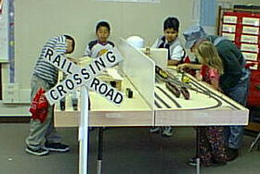
History
Physical evidence
Railroad realia
Artifacts at the two museums visited (railroad, historical)
Timeline: around the classroom near the ceiling
Presentations:
History of the Santa Maria Valley and the City
Overview of Railroading in the U.S.
History of the Santa Maria Valley railroads (several sessions)
Video: Sugar Beet Trains (Video Rails #VR074)
Early settlement of the area (Foxen, Miller, Cook, Blosser, Thornburg, etc.)
Conservation: every part of the sugar beet is used, either for sugar or for cattle feed

Slide 5
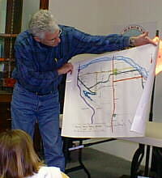
Geography
Relative Location: maps, HO layout, compass directions
Place characterization: farming, oil, coastal
Historical movement (Chumash - Settlers - Cities, California Mission trail)

Slide 6
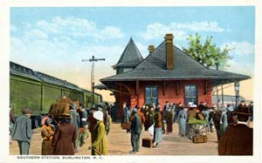
Economics
Farming: sugar beets, cattle, produce
Natural resources: oil
Transportation: railroads (major element and umbrella theme for the project)

Slide 7
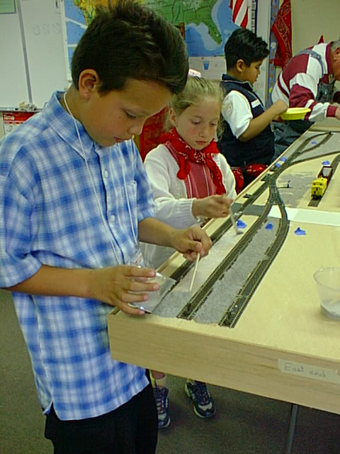
Culture
Chumash
Early Settlers
Early churches, schools, mercantiles of Santa Maria

Slide 8
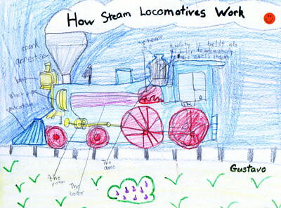
Reading and Writing
Timeline event descriptions
Short Stories. Using the unit's vocabulary, students wrote a short story including illustrations.
Final Report. Topics chosen include: the railroads of the valley, the Chumash, train signals, the first school, fire!, Hart House, steam locomotives, Capt. Hancock, the high school, sugar beets, and mule/horse teams.
Vocabulary. Activities/homework using these words included using them in sentences, crossword puzzles, etc.
Classroom Library
Thank You Notes for the 3 field trips

Slide 9
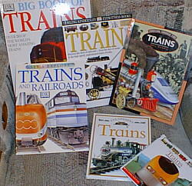
Study Skills
Classroom Library, including reading for main ideas
Paragraph summaries: each student's building
Field trips: railroad, railroad museum, historical museum
Present information in various formats (timelines, paragraphs, pictures, etc.)
Web research: see the Links section of the Overview page

Slide 10
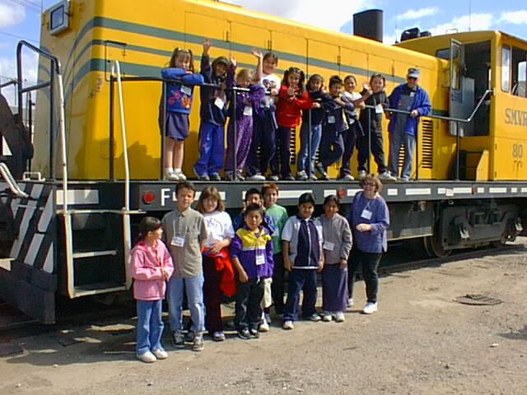
Visual Learning
Observation: field trips (railroad, railroad museum, historical museum, Amtrak trip), books, photos
Timelines
Chart: link dates, page numbers (of photos), events
Interpretation: photos, pictures, illustrations, artifacts all over the classroom
Symbols: railroad operations
Visual self-expression: drawings, reports, and other class activities

Slide 11
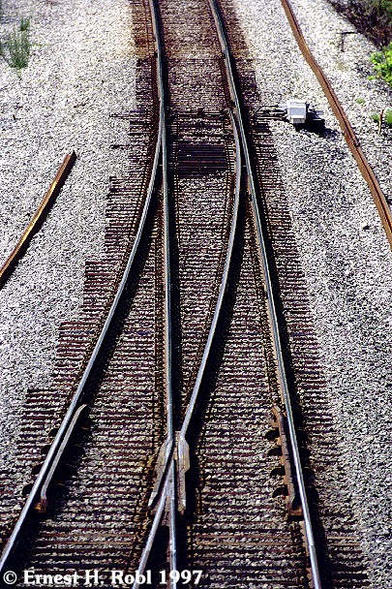
Map and Globe Skills
Read a map, symbols, keys, etc.
Location, coordinates
Follow routes
Scale (the HO train layout is 1:87) and distance
Construction and use: a 3-D HO layout, layout diagram

Slide 12
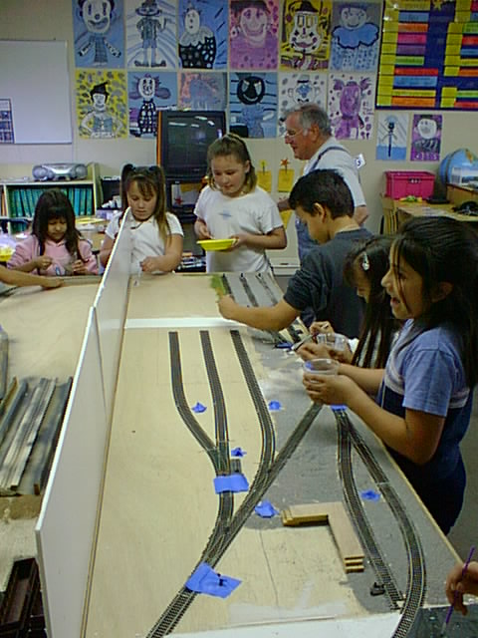
Critical Thinking
Evaluate and judge: search for and report on main ideas
Solve and conclude: cause and effect (train operations, among others)

Slide 13
T-Beam construction
Very light-weight
Super rigid

Slide 15
From Hal’s book…

Slide 19
Classroom space is limited. We were allowed a 4x8 area with walk-around area.
The layout was designed so that two operating crews could work, one on each side. The engineers (at the throttle) would be at the top, and two brakeman would be posted along each side to throw turnouts and toggles.

Slide 20
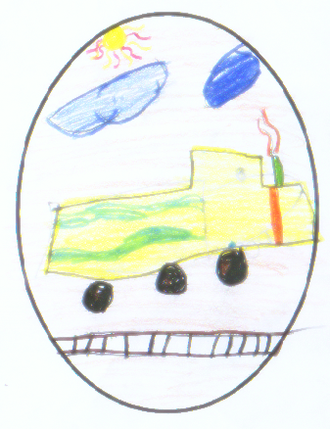
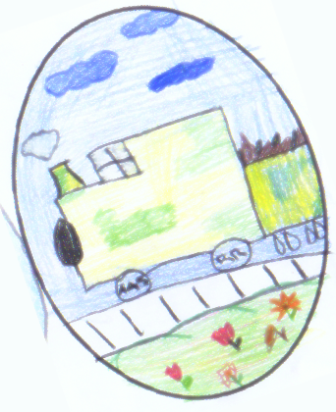
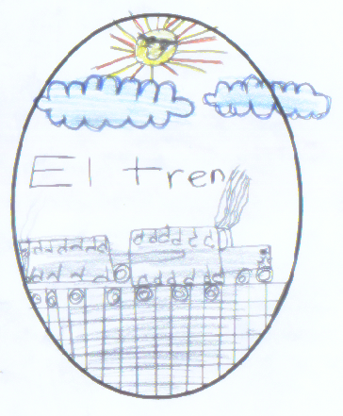
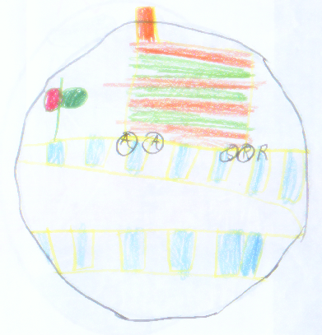
Developing a logo…

Slide 21
The Winner!

Slide 22
Name tags: particularly for field trips, but also to help visitors to the classroom (like the two railroaders leading the class).

Slide 23
Classroom Presentations

Slide 26
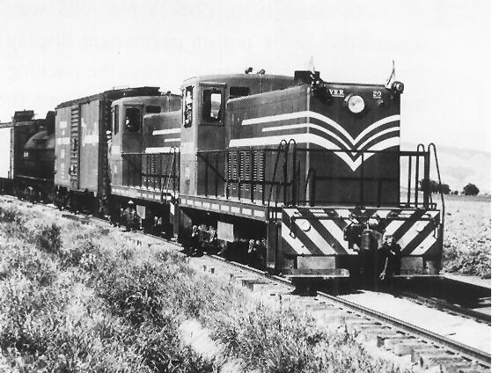
Slides about the history of the Santa Maria Valley Railroad

Slide 27
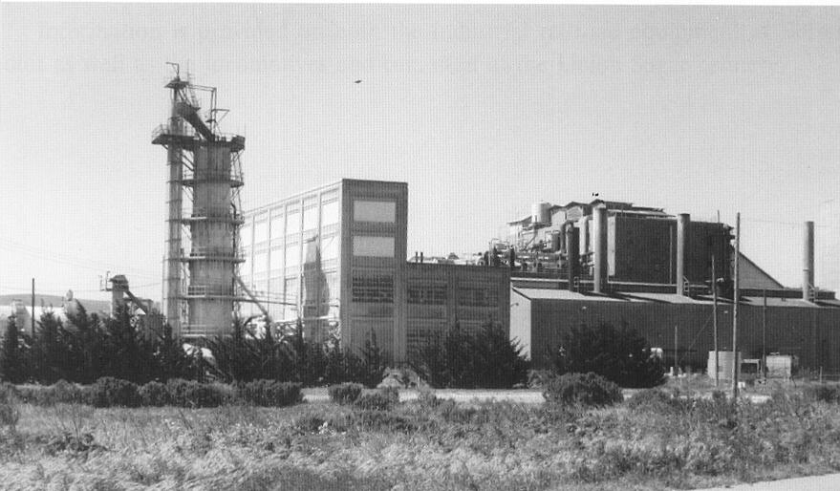

Slide 28
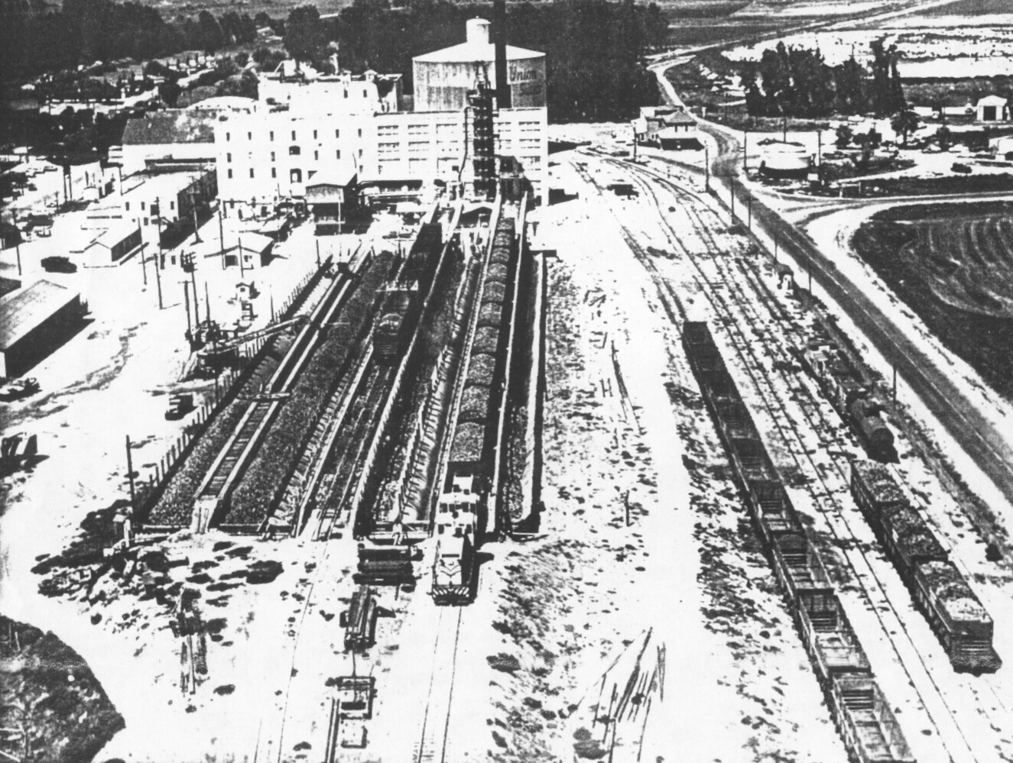

Slide 29
We planted sugar beet seeds.

Slide 30
Layout arrives in the classroom. Lots of finishing needed…

Slide 38
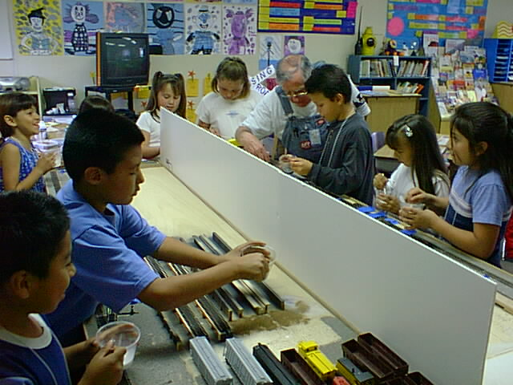

Slide 39
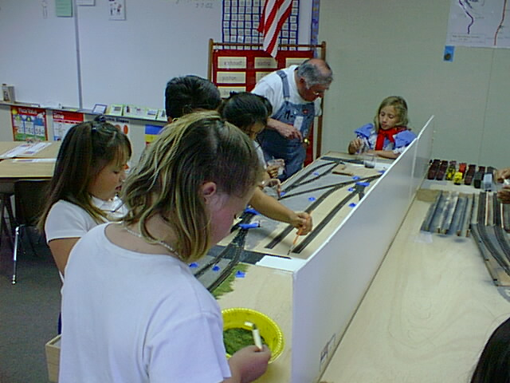

Slide 40
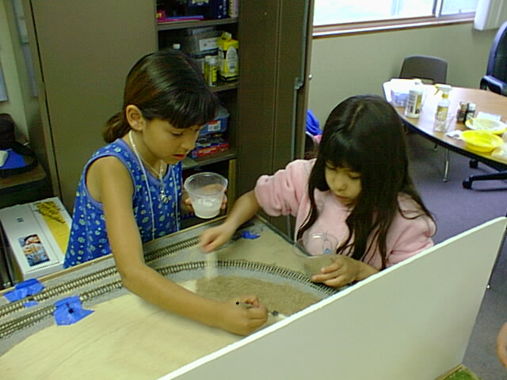

Slide 46
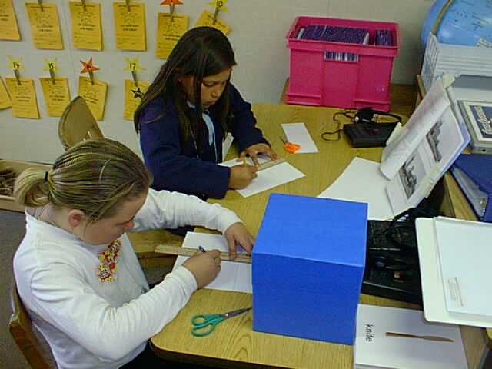

Slide 47
Vocabulary
Signals

Slide 53
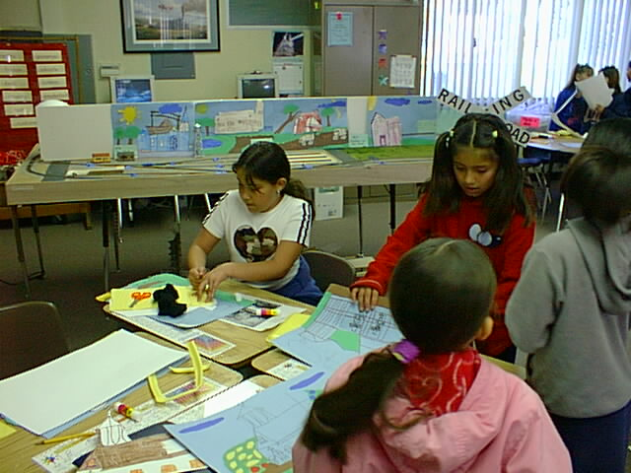

Slide 65
Visiting the Santa Maria Valley Railroad

Slide 68
Visiting the Santa Maria Historical Society’s Museum

Slide 72
Visiting the Santa Maria Valley Railway Historical Museum in the Mall

Slide 76
Amtrak field trip starts at Guadalupe.

Slide 82
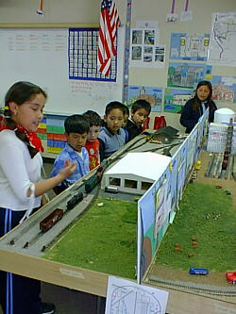
Dress rehearsal for first graders.

Slide 83
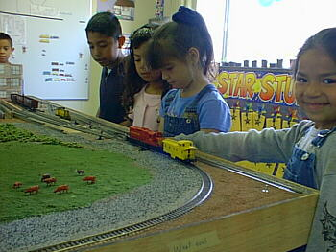

Slide 84
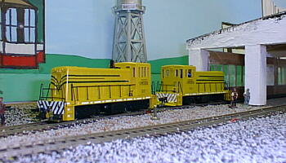

Slide 85
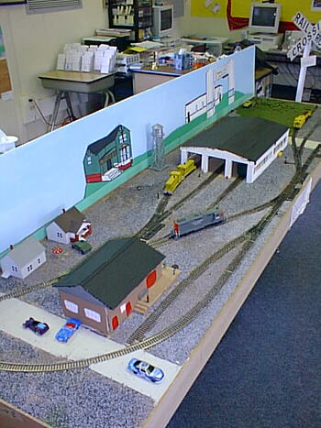

Slide 86
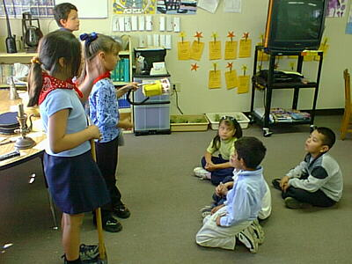

Slide 87
Open House

Slide 95
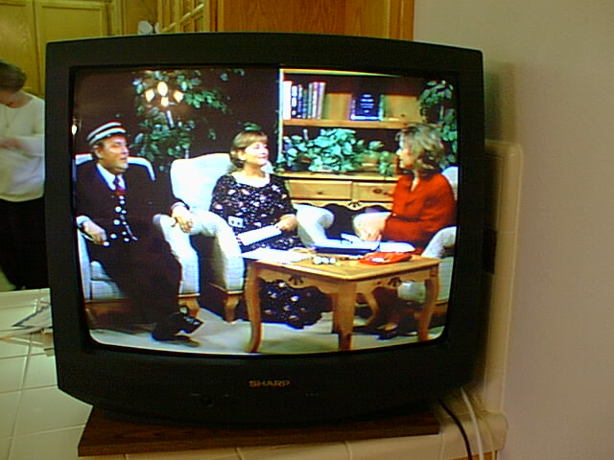

Slide 96
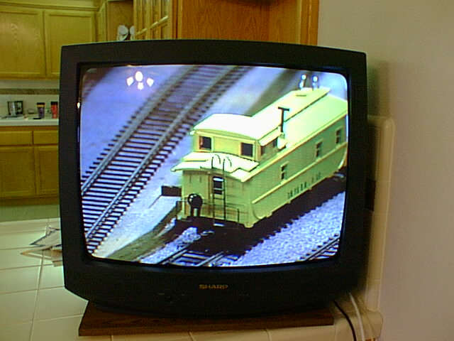

Slide 97
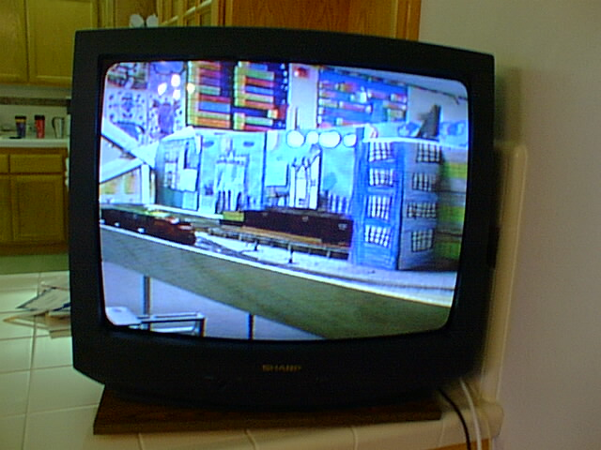

Slide 98
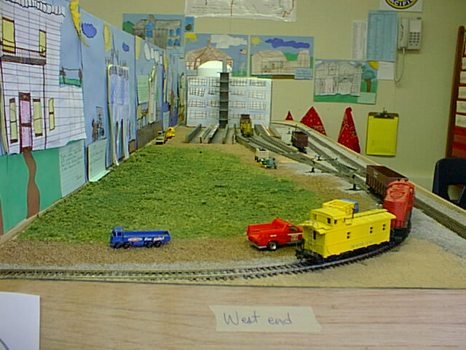

Slide 99
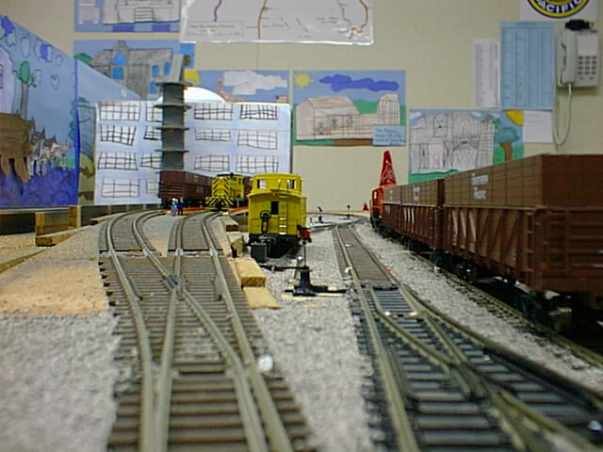

Slide 100
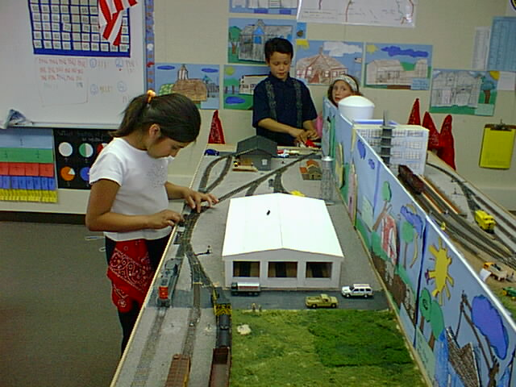

Slide 101
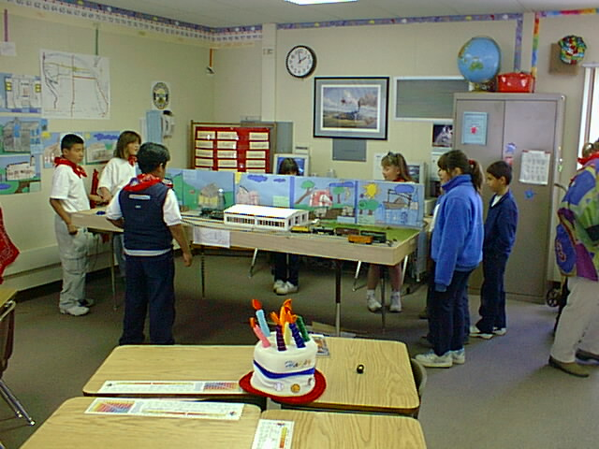

Slide 102
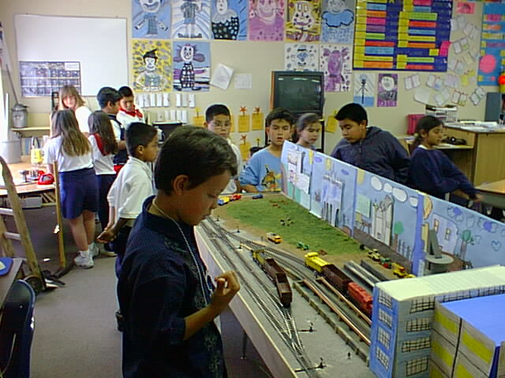

Slide 103
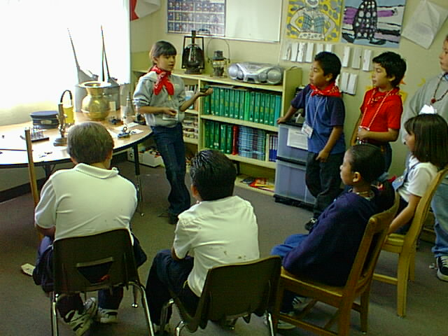

Slide 104
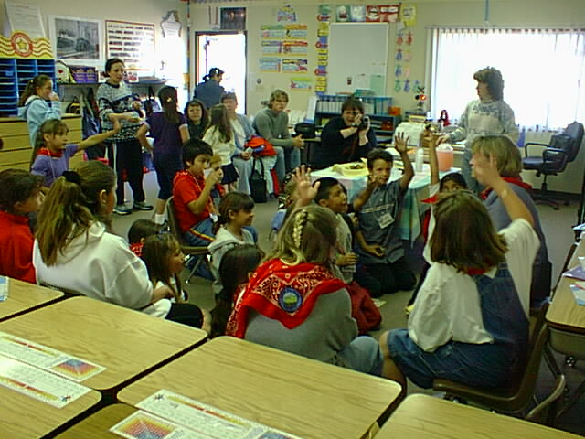

Slide 105
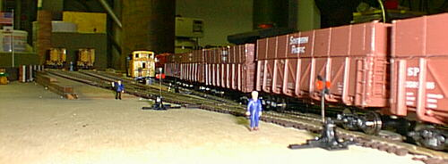
Working late at the sugar mill…

